Slide 1
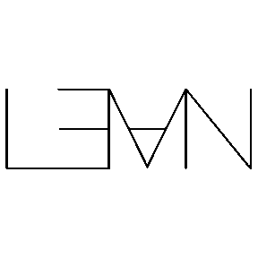
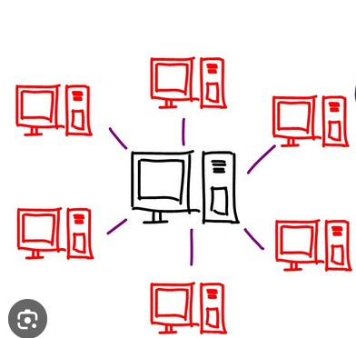
Choregraphies and Session Types
Master Thesis until April 2024 by me :)

Slide 2
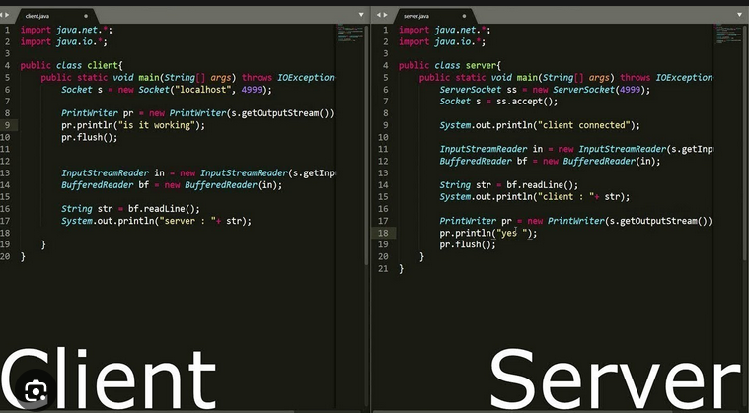
First Google search result for client/server program

Slide 3
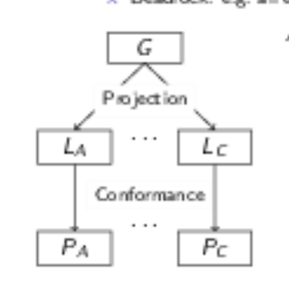
Choregraphies
Intuition of a „play“ or a dance choreo
A global description of computation and Communication
Combines send and receive in one operation
Think of MPI with MPI_Sendrecv()

Slide 4
Session Types
Describes the „communication protocol“ of parties as a type from a local view
Easier verification for deadlock-freedom safety and liveness
Traditional binary session types can be verified easily (duality)
Extensions to Multiparty Session Types exist

Slide 5
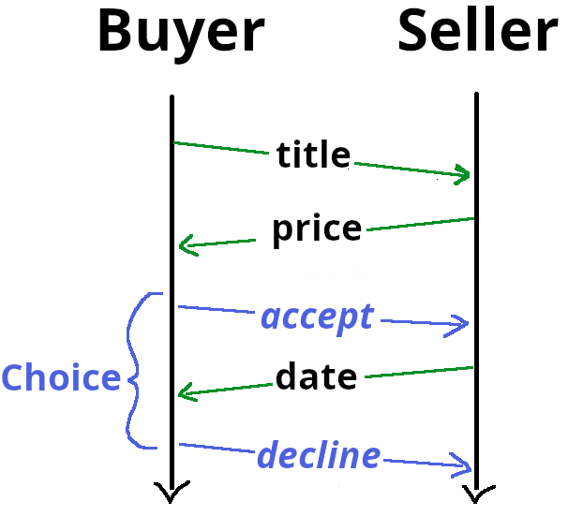
Example
Choreography:
requested_title@seller <= title@buyer
price@buyer <= price_of(requested_title)@seller
if (price < budget)@buyer
delivery_date@buyer <= delivery_date_of(requested_title)@seller
delivery_date@seller
else
0@buyer
Global Type string representation:
buyer --> seller: Nat.
seller --> buyer : Nat.
buyer--> (seller):
{
accept:
seller --> buyer: Nat.
end
[]decline:
end
}

Slide 6
Enpoint Projection
Projecting a Global Type (or program) to a session Type (or local program)
Session Type
?(buyer, Nat).
!(buyer, Nat).
choice@buyer{
!(buyer, Nat).
end
[]
end
}
Lean executable Program
def client2: IO Unit := do
let sock ← Socket.mk .inet .stream
let local_addr: Socket.SockAddr4 := .v4 (.mk 127 0 0 1) 4599
sock.connect local_addr
let requested_title ← sock.recvNat
sock.sendNat (price_of requested_title)
Let branch ← sock.recvBool
if (branch == true) then
sock.sendNat (delivery_date_of requested_title)
else
()

Slide 7
Further Goals
Extend sendable Types
Generate working Lean executable
Implement a few „real world examples“, like cryptographic protocols
Show that projecting a choreography to a location results in the same (or aquivalent) session type than projecting the corresponding Global Type to the location for my limited DSL

